Slide 1
IBM University Engagement Project Submission
“Exploring the Power of Agentic AI with IBM Granite and LangFlow”

Slide 2

Project Tile – Street Vendor Digitalization Agent
Domain of Project – Digital Commerce & MSME Empowerment
Student Name | Recent Passport Photo | Email ID | Mobile number [WhatsApp]
Gompana Melisa |  | melisagompana@gmail.com | 7287005337

Slide 3
Problem Statement: Street Vendor Digitalization Agent
The Challenge
Street vendors and micro-entrepreneurs play a vital role in the local economy, yet many struggle to establish a digital presence and access modern business opportunities. Information about digital payments, government MSME schemes, online business registration, local marketing, and customer engagement is scattered across multiple government portals, fintech platforms, and commerce websites. Without personalized, real-time guidance, vendors often miss opportunities to increase visibility, attract more customers, access financial support, and grow their businesses.
The Objective
Build an AI-powered Street Vendor Digitalization Agent that provides personalized digital business guidance and support for street vendors and micro-entrepreneurs. The solution should:
- Business Profile Generation – Create professional digital business profiles based on the vendor's products, services, and location.
- RAG-Based Information Retrieval – Fetch and summarize real-time information about MSME schemes, PM SVANidhi, digital payment guidelines, government policies, and business registration from trusted sources.
- Digital Payment & UPI Setup – Guide vendors through setting up UPI QR codes, digital wallets, and online payment systems.
- Local SEO & Marketing Support – Recommend Google Business Profile setup, local SEO strategies, online listing platforms, and promotional ideas to improve visibility.
- Multi-Agent System –
- Business Profile Agent (creates digital business profiles)
- Government Scheme Agent (retrieves MSME schemes, loans, and policy information)
- Digital Payment Agent (assists with UPI and QR code setup)
- Marketing & Customer Engagement Agent (suggests promotional campaigns, local SEO, and customer retention strategies)
- Business Insights Dashboard – Display digital onboarding progress, available government benefits, customer engagement recommendations, business growth insights, and marketing performance in a user-friendly dashboard.

Slide 4
Proposed Solution -
Proposed Solution: AI-Powered Street Vendor Digitalization Agent
The proposed solution is a multi-agent AI-powered Street Vendor Digitalization Agent built using LangFlow, IBM watsonx.ai, and IBM Granite Models to provide personalized, real-time digital business guidance for street vendors and micro-entrepreneurs. The system addresses challenges in digital onboarding, online visibility, digital payments, and business growth through an intelligent, modular architecture.
At its core, the solution uses a Retrieval-Augmented Generation (RAG) pipeline to fetch accurate information from trusted sources such as MSME portals, PM SVANidhi Scheme, Digital India resources, UPI guidelines, and government policies. This information is embedded and stored in a vector database, enabling the system to retrieve and summarize relevant business information using IBM Granite models.
The system consists of four key agents:
Business Profile Agent creates professional digital business profiles based on the vendor's products, services, and location.
Government Scheme Agent retrieves and summarizes information about MSME schemes, loans, subsidies, and business registration using RAG.
Digital Payment Agent provides step-by-step guidance for setting up UPI, QR codes, digital wallets, and secure online payment systems.
Marketing & Customer Engagement Agent recommends local SEO strategies, Google Business Profile setup, online listing platforms, pricing suggestions, promotional content, and customer engagement techniques.
The solution includes a user-friendly dashboard (built with Streamlit or React) that displays digital onboarding progress, available government schemes, business profile status, marketing recommendations, and customer engagement insights.
LangFlow is used to orchestrate agent workflows, while IBM watsonx.ai ensures scalable model deployment, embeddings, and AI governance. IBM Granite models power reasoning, retrieval, summarization, and personalized business recommendations.
Overall, this solution delivers an end-to-end intelligent digital business assistant that empowers street vendors to improve their digital presence, access government benefits, adopt digital payments, attract more customers, and grow their businesses in the hyperlocal economy.

Slide 5
Technology Used
LangFlow Platform – For designing and orchestrating multi-agent workflows visually.
IBM BOB (Build on IBM) – For developing, testing, and deploying the Street Vendor Digitalization Agent using IBM's AI development platform and tools.
IBM Granite Model – For eg. ibm-granite-3-2-8b – For natural language understanding, reasoning, business profile generation, and personalized business recommendations.
IBM Cloud – It provides the infrastructure to build, deploy, and scale the Street Vendor Digitalization Agent efficiently. IBM Cloud enables a reliable, secure, and scalable environment for deploying the Street Vendor Digitalization Agent.
RAG (Retrieval-Augmented Generation) – RAG fetches real-time information first from government portals, MSME schemes, UPI guidelines, and digital commerce platforms, then generates intelligent answers, making the Street Vendor Digitalization Agent more trustworthy and effective.
IBM watsonx.ai – For model deployment, embeddings, and AI governance.
Vector Database (FAISS/Chroma) – For RAG-based retrieval of MSME schemes, government policies, digital payment guidelines, and business information.

Slide 6
Langflow component Used -
1) Chat Input – Interface where street vendors enter their business details, queries, or requirements (text/voice), such as products sold, business location, or digitalization needs.
2) IBM watsonx AI Agent – Processes vendor input using IBM Granite models to generate personalized business profiles, government scheme recommendations, UPI setup guidance, and digital marketing suggestions.
3) Name of IBM Granite Model – Granite-4.0-8B-Instruct → Fast and efficient for real-time business guidance, reasoning, and personalized recommendations.
4) Chat Output – Displays AI-generated responses such as business profiles, MSME scheme details, UPI QR setup instructions, local SEO strategies, customer engagement tips, and promotional recommendations.
5) File Component – Stores and retrieves government policies, MSME scheme documents, digital payment guidelines, and business knowledge for RAG-based information retrieval.

Slide 7
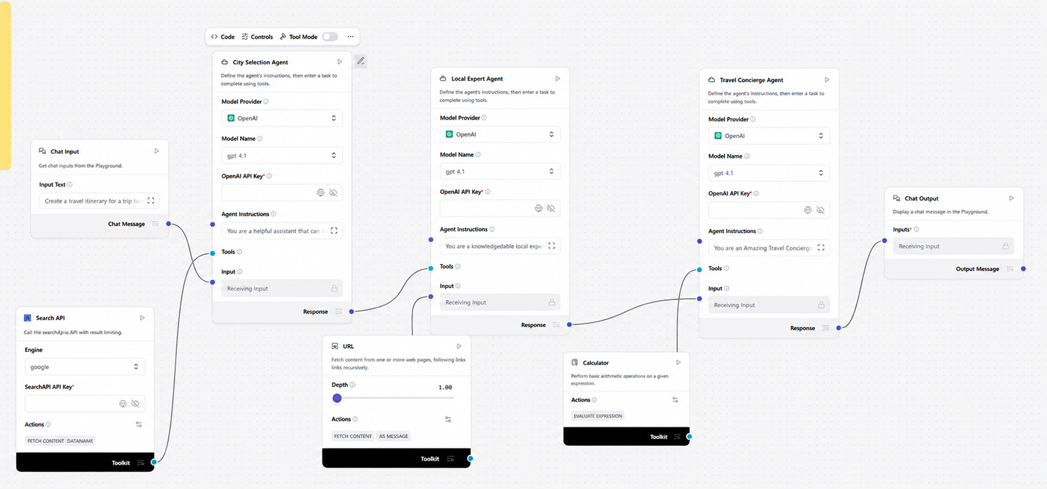
Langflow workflow -

Slide 8
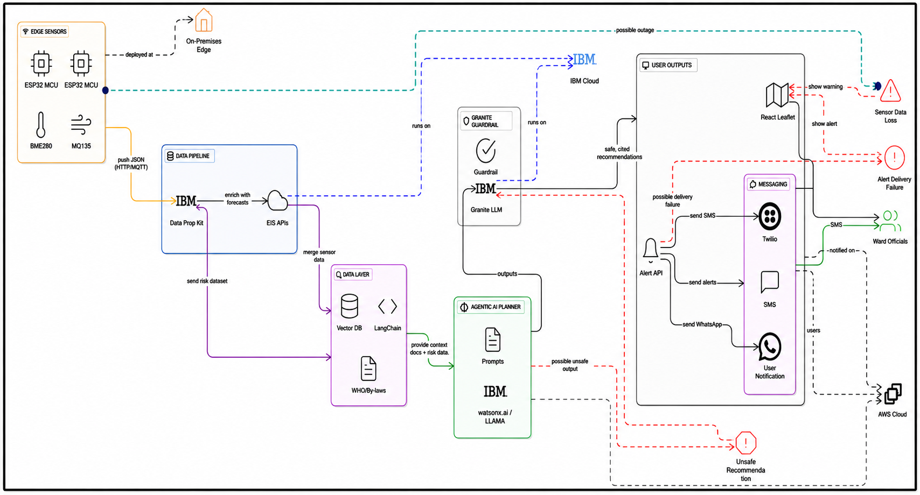
Architecture blueprint

Slide 9

Role of Agentic AI in the solution
Role of Agentic AI in Street Vendor Digitalization Agent
Agentic AI enables the Street Vendor Digitalization Agent to function as an intelligent, autonomous system rather than a simple chatbot. Using IBM watsonx.ai and IBM Granite models, it coordinates multiple specialized agents to deliver personalized digital business guidance.
Each agent performs a specific role—such as generating business profiles, retrieving government schemes, providing UPI setup guidance, and recommending local marketing strategies—while working collaboratively. This multi-agent approach ensures efficient task execution and accurate results.
Agentic AI also brings context awareness, understanding vendor details such as business type, products sold, location, and customer base to generate personalized recommendations. It supports real-time adaptation, continuously updating suggestions based on vendor inputs and the latest government policies.
Additionally, agents communicate with each other, enabling better decision-making and improved business outcomes.
Overall, Agentic AI makes the system proactive, personalized, and goal-driven, acting like a smart digital business assistant that helps street vendors establish a digital presence, access government benefits, attract more customers, and grow their businesses.

Slide 10
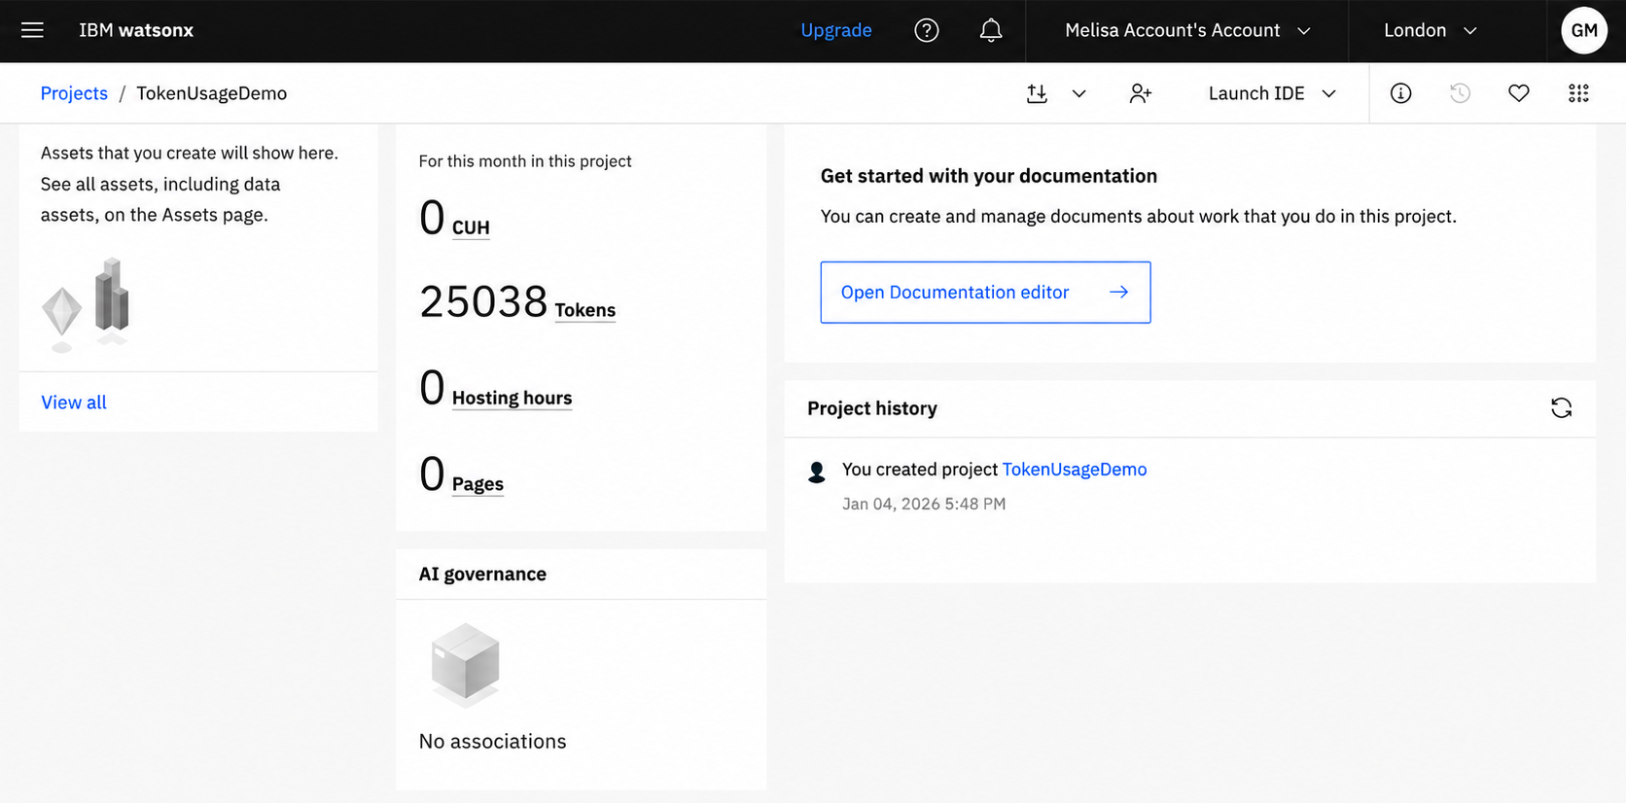
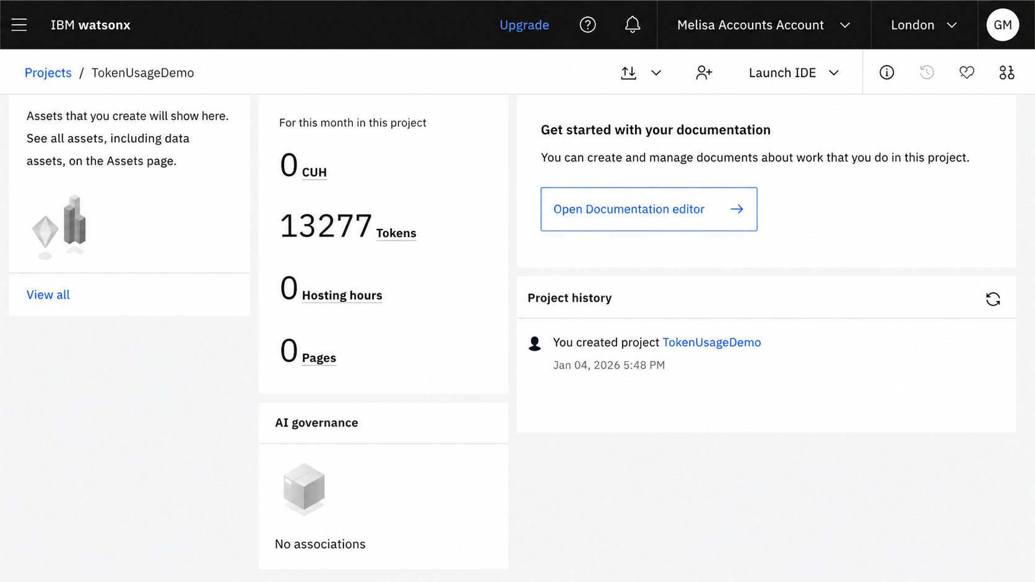
Token Usage
11,761 token are used
Before Prompt
After the Prompt
·
·
·

Slide 11
Novelty and Uniqueness
The proposed Street Vendor Digitalization Agent stands out by combining Agentic AI, RAG, and personalization into a single intelligent system.
Multi-Agent Intelligence – Instead of a single chatbot, multiple specialized agents collaborate to deliver accurate and context-aware digital business guidance.
RAG-Based Accuracy – Integrates real-time information retrieval from government portals, MSME schemes, UPI guidelines, and commerce platforms with AI generation, ensuring trustworthy and up-to-date recommendations.
Hyper-Personalization – Tailors business profiles, marketing strategies, and digital onboarding recommendations based on the vendor's business type, products, and location.
Real-Time Assistance – Continuously adapts recommendations based on vendor queries, business updates, and the latest government policies.
Multi-Modal Input – Supports text, voice, and image-based interactions, making the solution easy to use for vendors with different levels of digital literacy.
Business Growth Focus – Goes beyond digital onboarding by providing government scheme guidance, digital payment setup, local SEO strategies, and customer engagement recommendations.
Scalable & Enterprise-Ready – Built on IBM watsonx.ai, IBM Granite models, and IBM Cloud, ensuring reliability, scalability, and AI governance..

Slide 17
Git Hub Link
· Please create public github repository (Enable Add README button while creating repository) with format –
Please test and Paste the working Github URL –
Make sure you have Uploaded following three files into your github repository
1) app.json file , 2) yourproblemstatement.pdf file 3) your projectpresntation.pptx file 4)any other files
·
·
·

Slide 18
Future Scope
1. AI-Powered Voice Assistant & Multilingual Support –
The system can be enhanced with a voice-enabled assistant and support for multiple regional languages, allowing street vendors to interact naturally in their preferred language. This will improve accessibility and make the solution more inclusive for vendors with varying levels of digital literacy.
2. Integration with Digital Commerce & Financial Services –
The system can be integrated with digital payment platforms, e-commerce marketplaces, and government portals to provide real-time updates on MSME schemes, business registrations, UPI services, and financial assistance. This will help vendors expand their digital presence, improve customer reach, and access business growth opportunities more effectively.

Slide 19
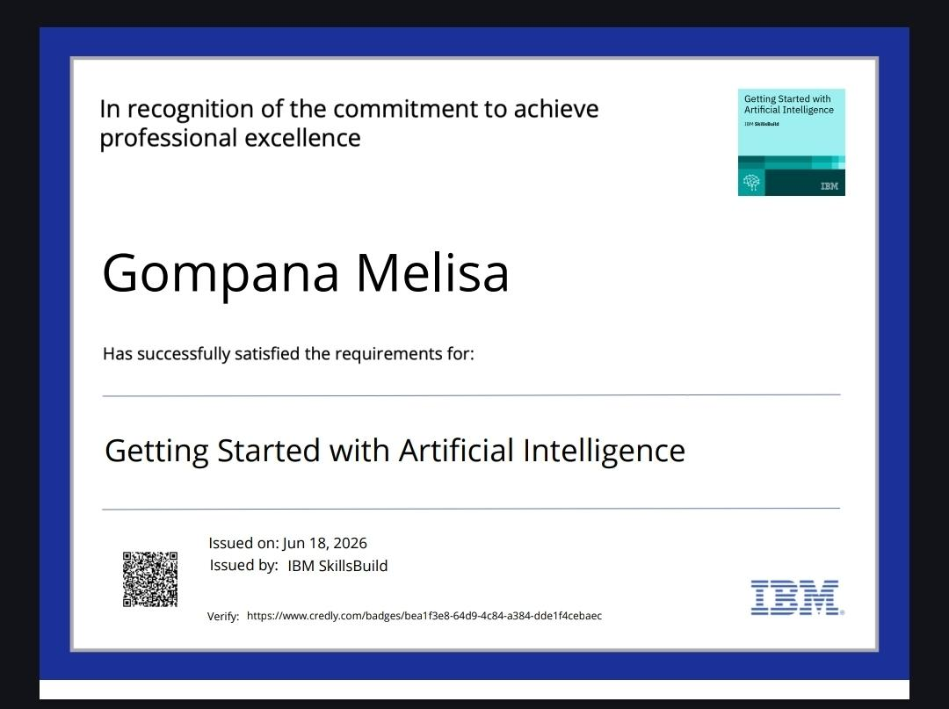
Certificates Earned:
Please add your credly certificate

Slide 20
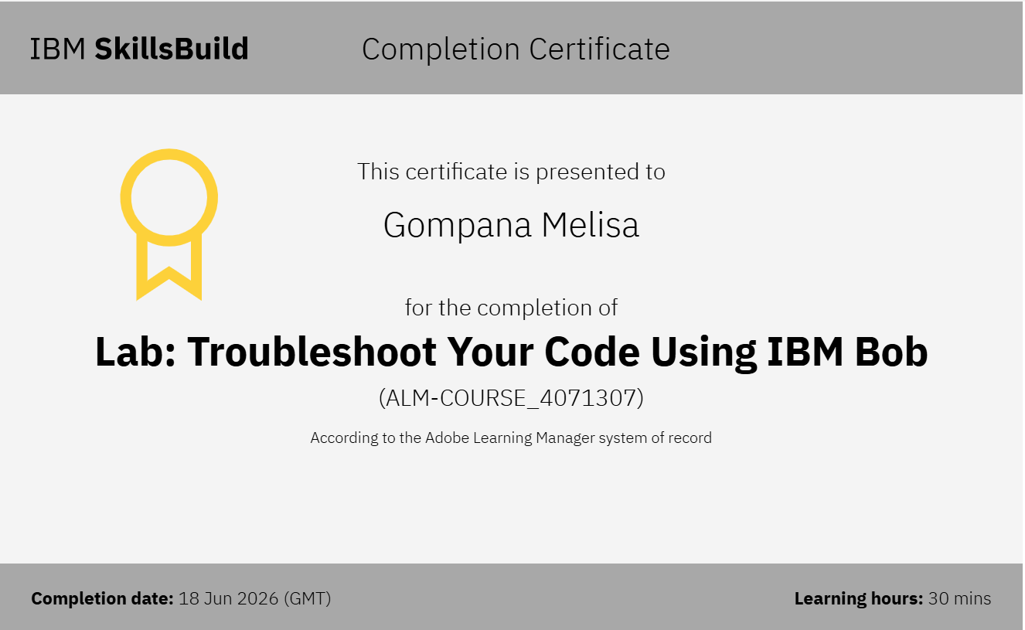
Certificates Earned:​
Add your IBM BOB Certificate

Slide 21

EFIBM26263550864@edunetmail.com
Edu#863082

